Slide 1
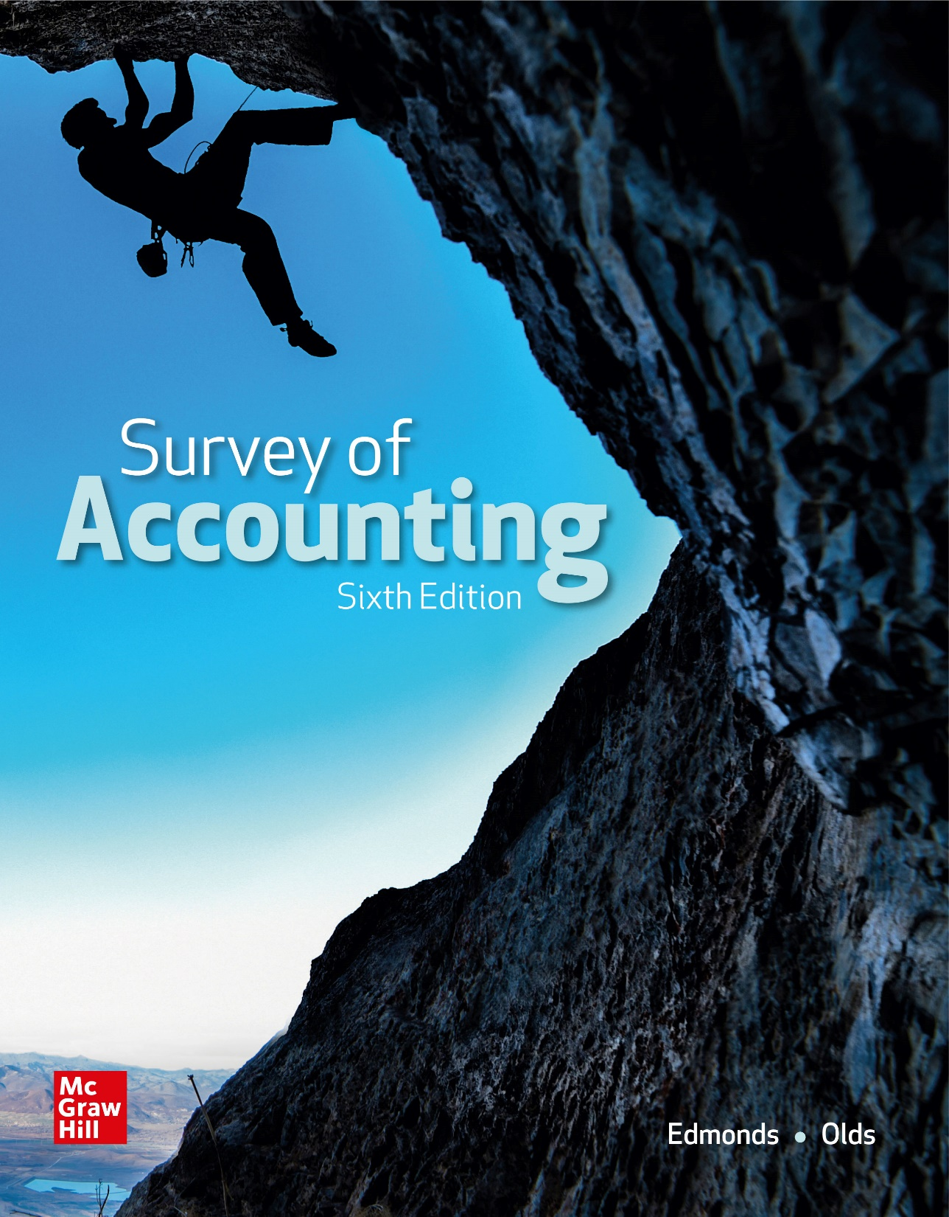
Chapter 8
Proprietorships, Partnerships, and Corporations

Slide 2
LO 8-1:
Identify the primary characteristics of sole proprietorships, partnerships, and corporations.

Slide 3
Forms of Business Organizations
Sole proprietorships are owned by a single individual who is responsible for making business and profit distribution decisions. Usually no legal ownership agreement is required.
Partnerships allow persons to share their talents, capital and risks and rewards of ownership. Two or more individuals share ownership. A partnership agreement defines responsibilities and describes how income or losses will be divided.
A corporation is a separate legal entity created by the authority of a state government. All states require the application to provide articles of incorporation.

Slide 4
Comparing Corporations with Proprietorships and Partnerships
Corporate Advantages
Separate legal Entity
Limited liability of stockholders
Continuous life
Management Structure
Easily transferable ownership rights
Ability to raise capital
Corporate Disadvantages
Governmental regulation
Corporate double taxation

Slide 5
Regulation
Regulation
Few laws specifically affect the operations of proprietorships and partnerships.
Corporations are usually heavily regulated.
Ownership can be transferred by exchanging stock certificates.
If trading is among individuals, the company is a closely held corporation.
A corporation may list its stock on an exchange such as the NYSE or NASDAQ.

Slide 6
Regulation (Continued)
Regulation (continued)
The stock market crash of 1929 led Congress to pass the Securities Act of 1933 and Securities Exchange Act of 1934 to regulate issuing stock and govern the exchanges.
The Securities and Exchange Commission (SEC) was created to enforce the securities laws and establish accounting principles for registered corporations.
The SEC has generally deferred its rule-making authority to the FASB.

Slide 7
Double Taxation
Double Taxation
Corporations pay income taxes on their earnings and then owners pay income taxes on distributions (dividends) received from corporations.
As a result, distributed corporate profits are taxed twice – first when income is reported on the corporation’s tax return and a second time when distributions are reported on individual owners’ tax returns.

Slide 8
Limited Liability and Continuity
Limited Liability
The corporate form limits an investor’s potential liability as an owner of a business venture. Creditors cannot claim owners’ personal assets as payment for the company’s debts.
Continuity
Unlike partnerships or proprietorships, which terminate with the departure of their owners, a corporation’s life continues when a shareholder dies or sells his or her stock.

Slide 9
Transferability of Ownership and Ability to Raise Capital
Transferability of Ownership
The transferability of corporate ownership is easy. An investor simply buys or sells stock.
Transferring the ownership of proprietorships and partnerships is much more difficult.
Ability to Raise Capital
Corporations have the opportunity to raise huge amounts of capital. Few individuals have the financing means to build a large corporation.

Slide 10
Management Structure
Management Structure
Partnerships and proprietorships are usually managed by their owners.
Corporations have three tiers of management authority.
The owners (stockholders) represent the highest level of organizational authority.
The stockholders elect a board of directors to oversee company operations.
The directors then hire professional executives to manage the company.

Slide 11
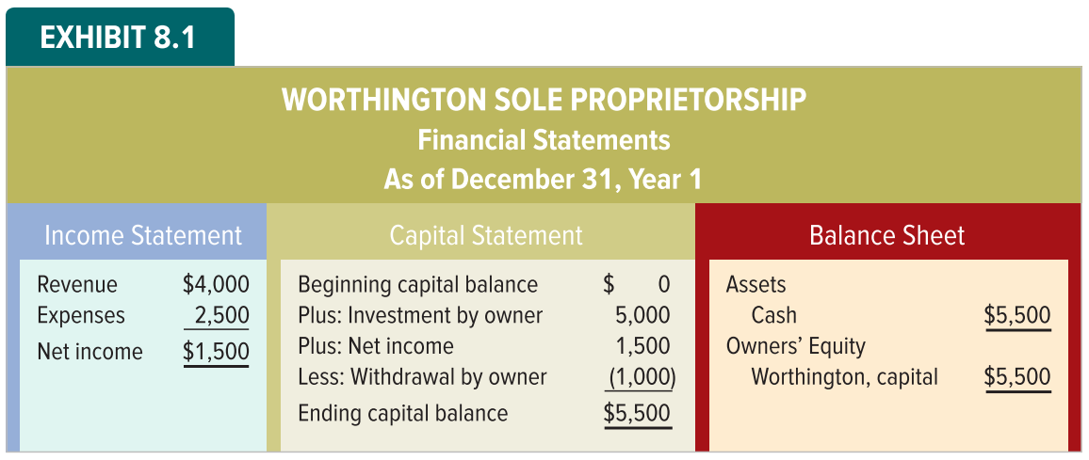
Presentation of Equity in Proprietorships

Slide 12
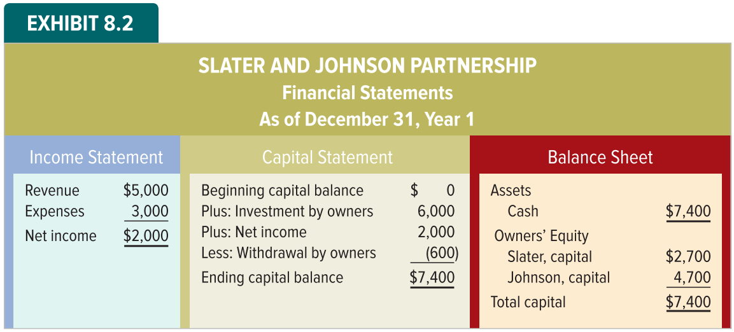
Presentation of Equity in Partnerships

Slide 13
LO 8-2:
Identify the characteristics of capital stock.

Slide 14
Characteristics of Capital Stock
Par Value
Many states require assigning a par value to stock, which represents the maximum liability of the investors. Par value multiplied by the number of shares issued represents the minimum amount of assets that must be retained, known as legal capital.
Stated Value
No-par stock may have a stated value. Like par value, stated value is an arbitrary amount assigned by the board of directors to the stock.

Slide 15
Characteristics of Capital Stock
Other Valuation Terminology
The price an investor must pay to purchase a share of stock is the market value. The sales price of a share of stock may be more or less than the par value.
Book value per share is calculated by dividing total stockholders’ equity by the number of shares of stock owned by investors.

Slide 16
Characteristics of Capital Stock
Stock: Authorized, Issued, and Outstanding
States approve the maximum number of shares of stock corporations are legally permitted to issue, called authorized stock.
Authorized stock that has been sold to the public is called issued stock.
Treasury stock is when a corporation buys back some of its issued stock from the public.
Outstanding stock (total issued stock minus treasury stock) is stock owned by investors outside the corporation.

Slide 17
LO 8-3:
Differentiate between common and preferred stock.

Slide 18
Common Stock
Common stockholders have the rights to:
Buy and sell stock
Share in the distribution of profits
Share in the distribution of assets in the case of liquidation
Vote on significant matters that affect the corporate charter
Participate in the election of directors

Slide 19
Preferred Stock
Many corporations also issue preferred stock, whose owners receive certain privileges relative to holders of common stock.
Preference as to assets in case of bankruptcy.
Preference as to dividends before common stockholders.
Preferred stockholders give up rights in other areas.
Preferred stockholders usually have no voting rights.
The amount of dividends is usually limited.

Slide 20
Preferred Stock Dividends
Cumulative
Noncumulative
Dividends in arrears must be paid before dividends may be paid on common stock.
Undeclared dividends from current and prior years do not have to be paid in future years.
Most preferred stock is cumulative.

Slide 21
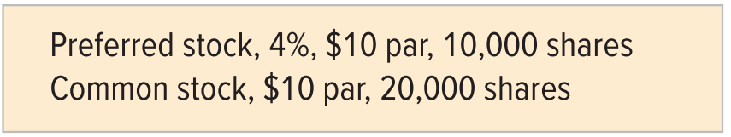
Example of Preferred Stock Dividends
Dillion, Incorporated has the following stock outstanding:
Assume the preferred stock dividend has not been paid for two years. If Dillion pays $22,000 in dividends, how much will each class of stock receive?

Slide 22
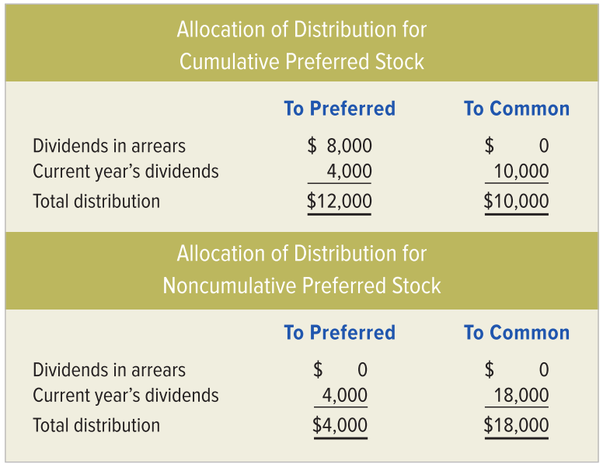
Preferred Stock Dividends
The distribution depends on whether the preferred stock is cumulative or noncumulative.

Slide 23
LO 8-4:
Show how issuing different classes of stock affects financial statements.

Slide 24
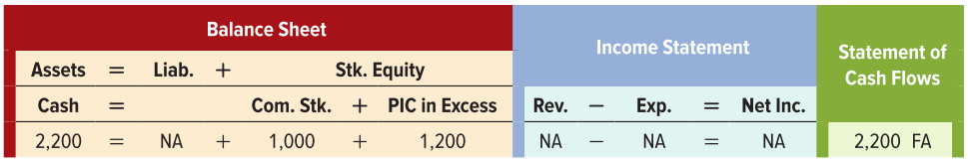
Accounting for Stock Transactions on the Day of Issue
Issuing Par Value Stock
Assume that Nelson Incorporated is authorized to issue 250 shares of common stock. During Year 1, Nelson issued 100 shares of $10 par common stock for $22 per share.
100 shares × $22 per share = $2,200
100 shares × $10 par value = $1,000

Slide 25
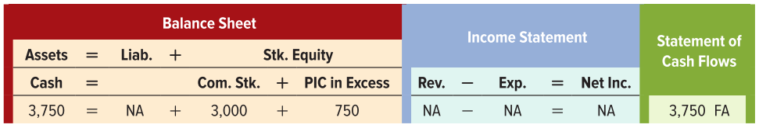
Accounting for Stock Transactions on the Day of Issue
Stock Classification
Assume that Nelson Incorporated obtains authorization to issue 400 shares of Class B, $20 par value common stock. The company issues 150 shares of this stock at $25 per share.
150 shares × $25 per share = $3,750
150 shares × $20 par value = $3,000

Slide 26
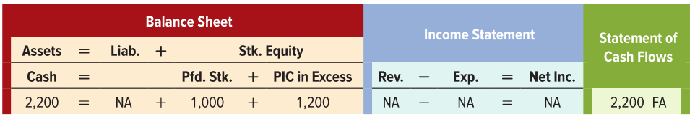
Accounting for Stock Transactions on the Day of Issue
Stock Issued at Stated Value
Assume Nelson is authorized to issue 300 shares of a third class of stock, 7 percent cumulative preferred stock with a stated value of $10 per share. Nelson issued 100 shares at a price of $22 per share.
100 shares × $22 per share = $2,200
100 shares × $10 par value = $1,000

Slide 27
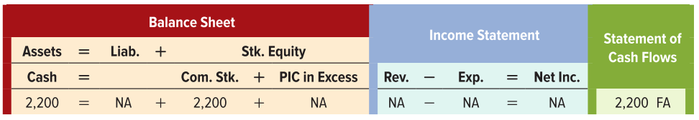
Accounting for Stock Transactions on the Day of Issue
Stock Issued with No Par Value
Assume that Nelson Incorporated is authorized to issue 150 shares of a fourth class of stock, no-par common stock. Nelson issues 100 shares of this no-par stock at $22 per share.
100 shares × $22 per share = $2,200

Slide 28
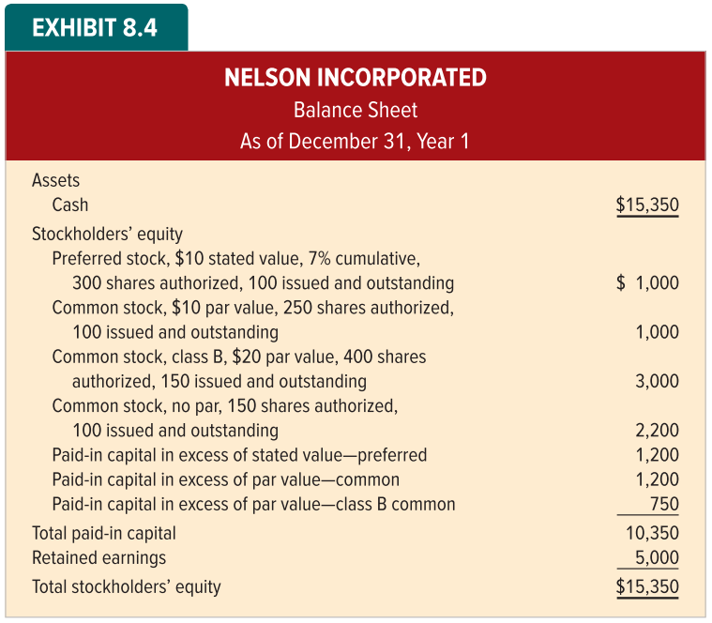
Financial Statement Presentation of Common and Preferred Stock

Slide 29
LO 8-5:
Show how treasury stock affects financial statements.

Slide 30
Treasury Stock
Treasury stock is when a company buys its own stock. Why would a company do this?
To have stock available to give employees pursuant to stock option plans.
To accumulate stock in preparation for a merger or business combination.
To reduce the number of shares outstanding in order to increase earnings per share.
To keep the price of the stock high when it appears to be falling.
To avoid a hostile takeover.

Slide 31
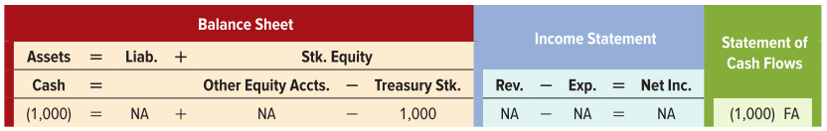
Purchase of Treasury Stock
Assume that in Year 2 Nelson paid $20 per share to buy back 50 shares of the $10 par value stock that it originally issued at a price of $22 per share.
50 shares × $20 per share = $1,000

Slide 32
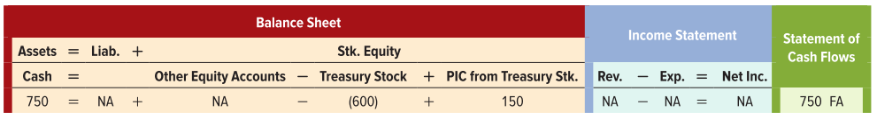
Reissue of Treasury Stock
Assume Nelson reissues 30 shares of treasury stock at a price of $25 per share.
The $150 difference between the cost of the treasury stock ($20 per share x 30 shares = $600) and the sales price ($750) is not reported as a gain. The $150 is additional paid-in capital.

Slide 33
LO 8-6:
Show how declaring and paying cash dividends affect financial statements.

Slide 34
Cash Dividends
Cash dividends are affected by three significant dates:
The declaration date,
The date of record,
The payment date.
Assume that on October 15, Year 2 the board of Nelson Incorporated declared a 7 percent cash dividend on the 100 outstanding shares of its $10 states value preferred stock. The dividend will be paid to stockholders of record as of November 15, Year 2. The cash payment will be make on December 15, Year 2.

Slide 35
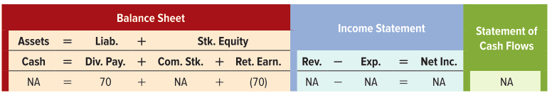
Declaration Date
Although corporations are not required to declare dividends, they are legally obligated to pay dividends once they have been declared. They must recognize a liability on the declaration date.
0.07 × $10 par × 100 shares = $70

Slide 36
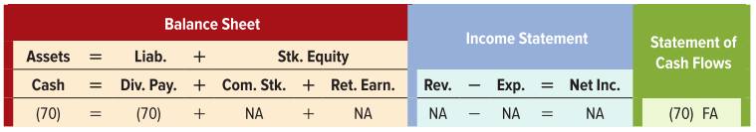
Date of Record and Payment Date
Date of Record
Cash dividends are paid to investors who owned the preferred stock on the date of record. The date of record is merely a cutoff date. No entry required.
Payment Date
Nelson actually paid the cash dividend on the payment date.

Slide 37
LO 8-7:
Show how stock dividends and stock splits affect financial statements.

Slide 38
Stock Dividends
Distribution of additional shares of stock to stockholders.
No change in total stockholders’ equity.
No change in par values.
All stockholders retain same percentage ownership.

Slide 39
Stock Splits
Stock splits replace existing shares with a greater number of new shares.
A company may use stock splits to reduce the market price per share of its outstanding stock.
The number of outstanding shares increases, and par value is decreased proportionately.
Retained earnings is not affected.

Slide 40
Example of a Stock Split
Nelson’s Board of Directors declared a 2-for-1 stock split on the 165 outstanding shares of its $20 par value, Class B common stock.

Slide 41
Example of a Stock Split Continued
Nelson’s Board of Directors declared a 2-for-1 stock split on the 165 outstanding shares of its $20 par value, Class B common stock.
Increase
Decrease
No Change
No journal entry required — Change par value and number of shares authorized and outstanding.

Slide 42
LO 8-8:
Show how the appropriation of retained earnings affects financial statements.

Slide 43
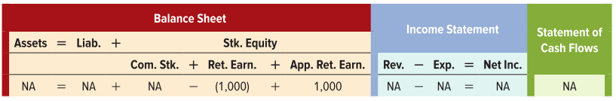
Appropriation of Retained Earnings
The board of directors may restrict the amount of retained earnings available to distribute as dividends. It may be required, or it may be discretionary. A retained earnings restriction is often called an appropriation.
Assume that Nelson’s Board of Directors appropriated $1,000 of retained earnings for future expansion.

Slide 44
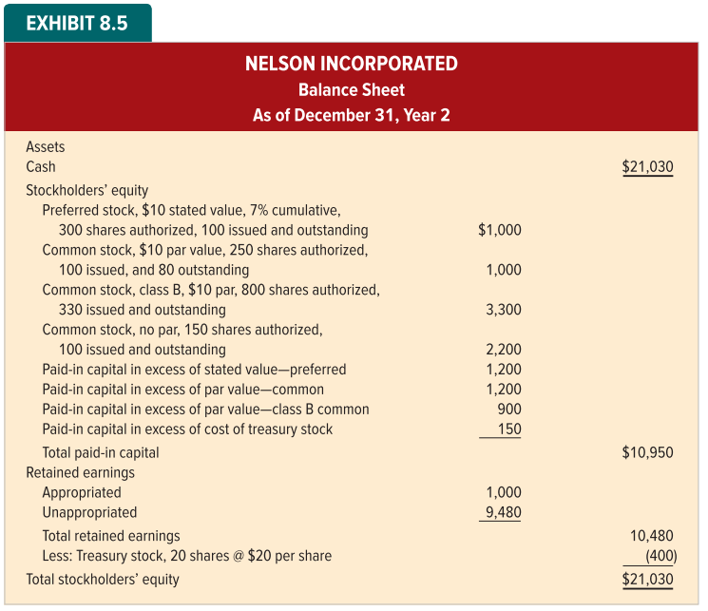
Financial Statement Presentation of Retained Earnings

Slide 45
LO 8-9:
Show how accounting information is used to make stock investment decisions.

Slide 46
Investing in Capital Stock
Stockholders may benefit in two ways when a company generates earnings.
The company may distribute the earnings directly to the stockholders in the form of dividends.
The company may retain some or all of the earnings to finance growth and increase its potential for future earnings, which should make the market value of its stock increase.

Slide 47
Exercising Control through Stock Ownership
The more influence an investor has over the operations of a company, the more the investor can benefit from owning stock.
The greater the number of stockholders, the more widely held a company is.
Stock concentrated in the hands of a few persons means that a company is closely held.

Slide 48
End of Chapter 8

